Slide 1
Modelling unemployment – a refreshing look at regression and TableBuilder
October 2019

Slide 2
What we’ll answer
Are men or women more likely to be unemployed?
Does education protect people from unemployment?
Does unemployment vary between states?
Is statistics fun or scary? (Sometimes both but mostly fun)
Notes:
I hate text on slides, but they’re a more helpful resource in the long-run

Slide 3
What we’ll cover
Recap of:
Logistic regression
Multilevel models
Why some TableBuilder output is effectively unit-record data
A simple unemployment model
Ask questions, let me know if you spot a mistake, and don’t forget to eat!

Slide 4
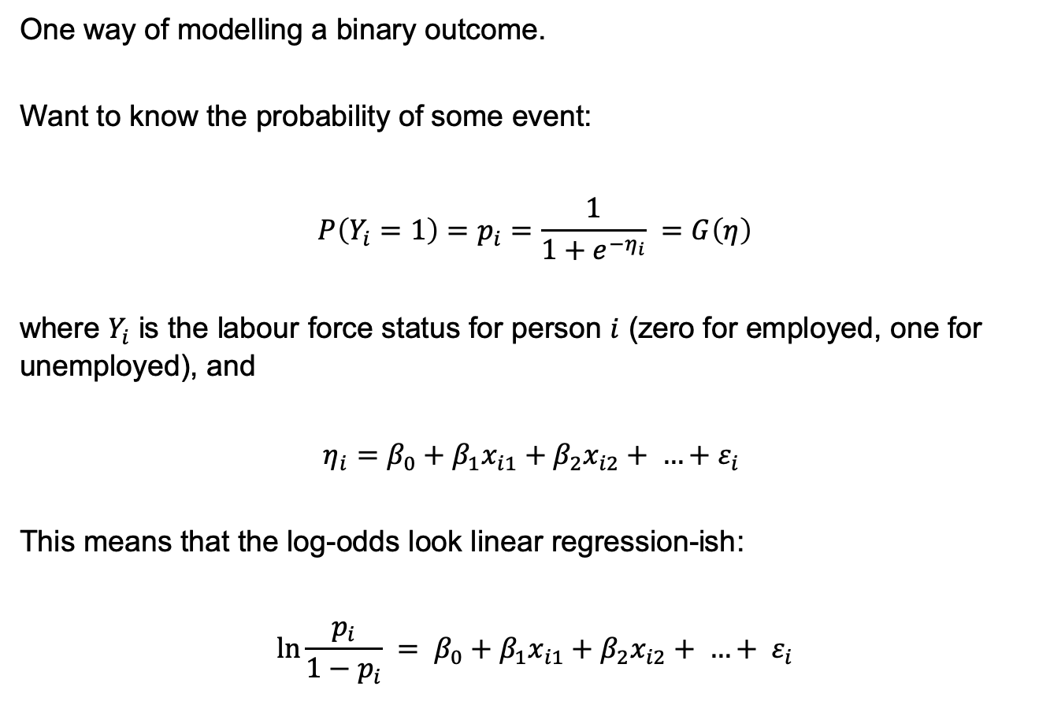
Logistic regression
One way of modelling a binary outcome.
Want to know the probability of some event:
$$P\left(Y_{i}=1\right)=p_{i}=\frac{1}{1+e^{−η_{i}}} =G\left(η\right)$$
where $Y_{i}$ is the labour force status for person $i$ (zero for employed, one for unemployed), and
$$η_{i}=β_{0}+β_{1}x_{i1}+β_{2}x_{i2}+ …+ε_{i}$$
This means that the log-odds look linear regression-ish:
$${\ln{\frac{p_{i}}{1−p_{i}}} = β}_{0}+β_{1}x_{i1}+β_{2}x_{i2}+ …+ ε_{i}$$
Notes:
We can do this totally equation-free and just talk about the concepts, or we can talk about the equations. Let’s vibe it.
The first equation is about probability.
The second equation is about linear regression, which will hopefully look familiar
The third equation just combines the two points

Slide 5
Logistic regression
One way of modelling a binary outcome.
Want to know the probability of some event:
$$P\left(Y_{i}=1\right)=p_{i}=\frac{1}{1+e^{−η_{i}}} =G\left(η\right)$$
where $Y_{i}$ is the labour force status for person $i$ (zero for employed, one for unemployed), and
$$η_{i}=β_{0}+β_{1}x_{i1}+β_{2}x_{i2}+ …+ε_{i}$$
This means that the log-odds look linear regression-ish:
$${\ln{\frac{p_{i}}{1−p_{i}}} = β}_{0}+β_{1}x_{i1}+β_{2}x_{i2}+ …+ ε_{i}$$
Notes:
Here’s something that looks like linear regression. Now let’s talk about what we actually want to predict

Slide 6
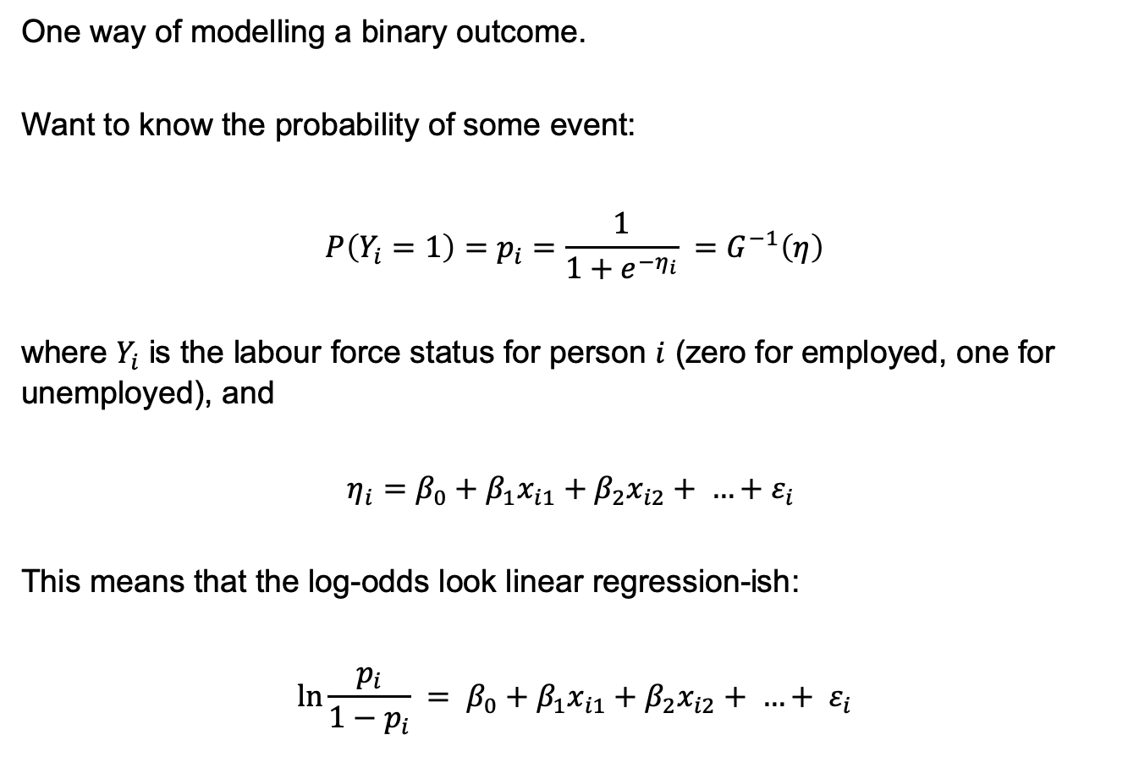
Logistic regression
One way of modelling a binary outcome.
Want to know the probability of some event:
$$P\left(Y_{i}=1\right)=p_{i}=\frac{1}{1+e^{−η_{i}}} =G^{−1}\left(η\right)$$
where $Y_{i}$ is the labour force status for person $i$ (zero for employed, one for unemployed), and
$$η_{i}=β_{0}+β_{1}x_{i1}+β_{2}x_{i2}+ …+ε_{i}$$
This means that the log-odds look linear regression-ish:
$${\ln{\frac{p_{i}}{1−p_{i}}} = β}_{0}+β_{1}x_{i1}+β_{2}x_{i2}+ …+ ε_{i}$$
Notes:
Let’s walk through the first equation

Slide 7
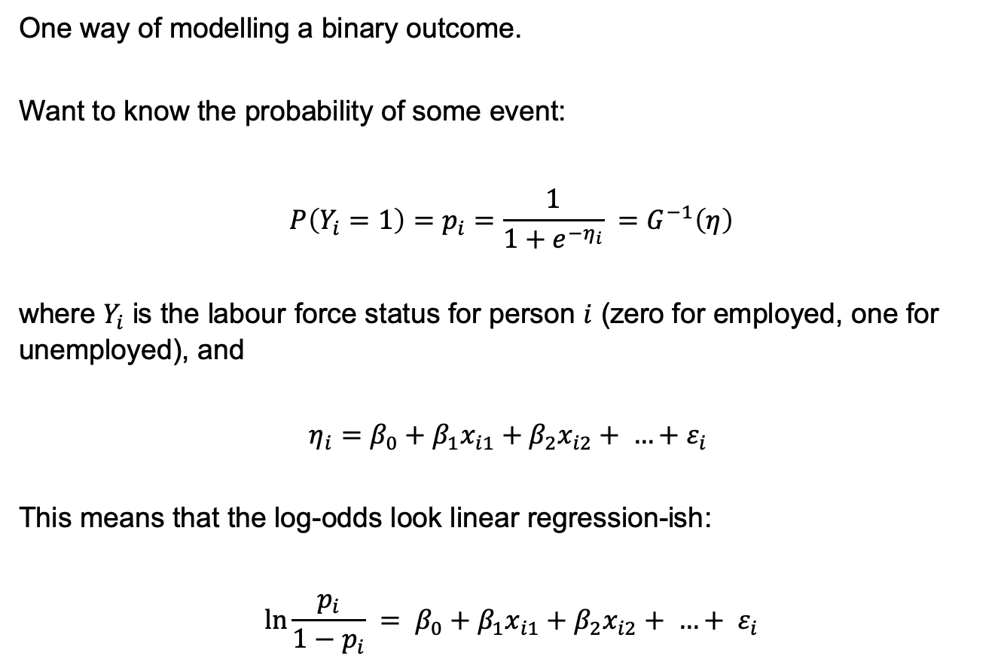
Logistic regression
One way of modelling a binary outcome.
Want to know the probability of some event:
$$P\left(Y_{i}=1\right)=p_{i}=\frac{1}{1+e^{−η_{i}}} =G^{−1}\left(η\right)$$
where $Y_{i}$ is the labour force status for person $i$ (zero for employed, one for unemployed), and
$$η_{i}=β_{0}+β_{1}x_{i1}+β_{2}x_{i2}+ …+ε_{i}$$
This means that the log-odds look linear regression-ish:
$${\ln{\frac{p_{i}}{1−p_{i}}} = β}_{0}+β_{1}x_{i1}+β_{2}x_{i2}+ …+ ε_{i}$$
Probability of unemployment

Slide 8
Logistic regression
One way of modelling a binary outcome.
Want to know the probability of some event:
$$P\left(Y_{i}=1\right)=p_{i}=\frac{1}{1+e^{−η_{i}}} =G^{−1}\left(η\right)$$
where $Y_{i}$ is the labour force status for person $i$ (zero for employed, one for unemployed), and
$$η_{i}=β_{0}+β_{1}x_{i1}+β_{2}x_{i2}+ …+ε_{i}$$
This means that the log-odds look linear regression-ish:
$${\ln{\frac{p_{i}}{1−p_{i}}} = β}_{0}+β_{1}x_{i1}+β_{2}x_{i2}+ …+ ε_{i}$$
Also the probability of unemployment

Slide 9
Logistic regression
One way of modelling a binary outcome.
Want to know the probability of some event:
$$P\left(Y_{i}=1\right)=p_{i}=\frac{1}{1+e^{−η_{i}}} =G^{−1}\left(η\right)$$
where $Y_{i}$ is the labour force status for person $i$ (zero for employed, one for unemployed), and
$$η_{i}=β_{0}+β_{1}x_{i1}+β_{2}x_{i2}+ …+ε_{i}$$
This means that the log-odds look linear regression-ish:
$${\ln{\frac{p_{i}}{1−p_{i}}} = β}_{0}+β_{1}x_{i1}+β_{2}x_{i2}+ …+ ε_{i}$$
This is the ugly bit,
the ‘logistic’ function
Notes:
We need the logistic function because probability only exists between 0 and 1. We can’t have probabilities outside that range. The logistic function ensures that no matter what number we throw into it, we get a number between 0 and 1. And helpfully, if we throw a bigger number into the logistic function, we get a higher probability. If we put in a smaller number, we get a lower probability.

Slide 10
Logistic regression
One way of modelling a binary outcome.
Want to know the probability of some event:
$$P\left(Y_{i}=1\right)=p_{i}=\frac{1}{1+e^{−η_{i}}} =G^{−1}\left(η\right)$$
where $Y_{i}$ is the labour force status for person $i$ (zero for employed, one for unemployed), and
$$η_{i}=β_{0}+β_{1}x_{i1}+β_{2}x_{i2}+ …+ε_{i}$$
This means that the log-odds look linear regression-ish:
$${\ln{\frac{p_{i}}{1−p_{i}}} = β}_{0}+β_{1}x_{i1}+β_{2}x_{i2}+ …+ ε_{i}$$
It’s also the
inverse of
the ‘logit link’

Slide 11
What we’ll cover
Recap of:
Logistic regression
Multilevel models
Why some TableBuilder output is effectively unit-record data
A simple unemployment model

Slide 12
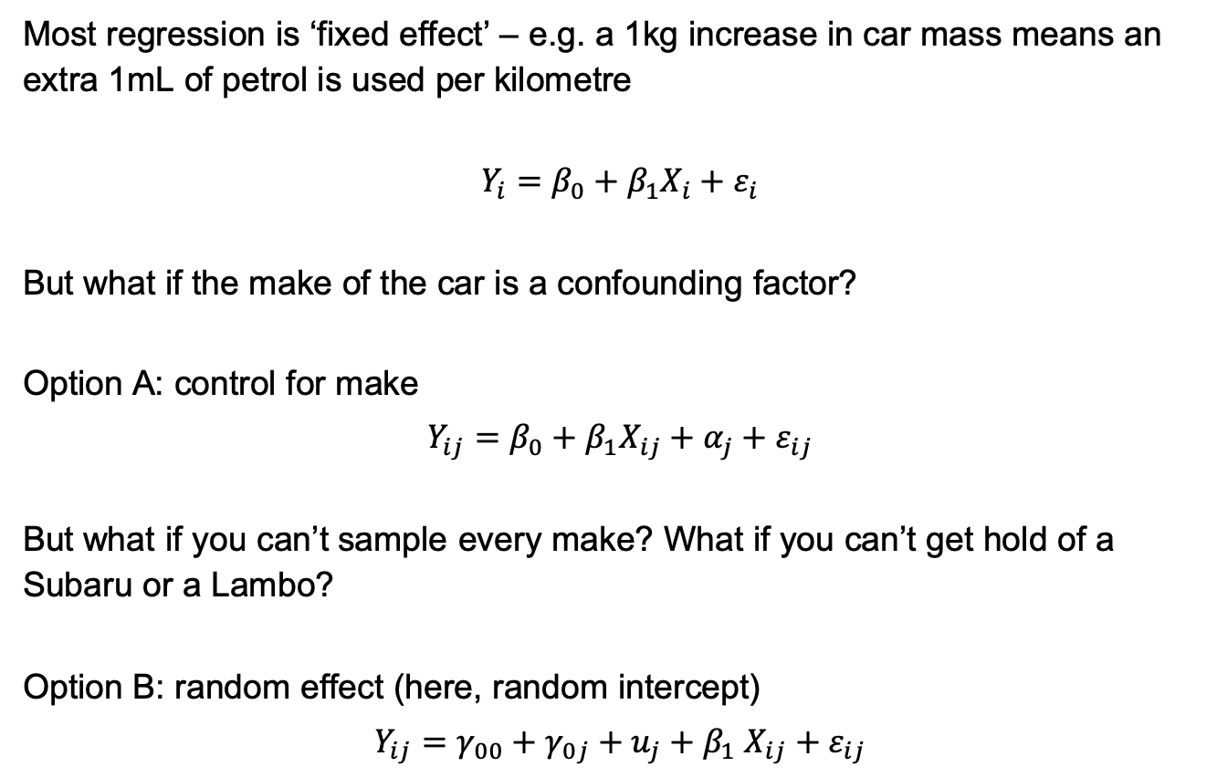
Multilevel modelling (or ‘mixed effect’ modelling)
Most regression is ‘fixed effect’ – e.g. a 1kg increase in car mass means an extra 1mL of petrol is used per kilometre
$$Y_{i}=β_{0}+β_{1}X_{i}+ε_{i}$$
But what if the make of the car is a confounding factor?
Option A: control for make
$$Y_{ij}=β_{0}+β_{1}X_{ij}+α_{j}+ε_{ij}$$
But what if you can’t sample every make? What if you can’t get hold of a Subaru or a Lambo?
Option B: random effect (here, random intercept)
$$Y_{ij}=γ_{00}+γ_{0j}+u_{j}+β_{1} X_{ij}+ε_{ij}$$

Slide 13
Multilevel modelling (or ‘mixed effect’ modelling)
Four reasons to use it:
Observations from the same group are not independent – they will have some correlated characteristics
We can separate the effect of unobserved group-level factors from individual-level factors
We can estimate group effects simultaneously with the effects of group-level predictors
We can draw inference on about a population of groups even if we’ve only sampled a subset of the groups
Notes:
Source: http://www.bristol.ac.uk/cmm/learning/multilevel-models/what-why.html
Standard regression treats the units of analysis as independent observations. Hierarchical data/clustering breaks this.
We may interested in separating the effect of unobserved group-level factors from individual-level factors (e.g. the effect of a school on its students, controlling for prior attainment)
We may want to measure the effect of group-level factors (such as state) while still allowing for clustering (by SA4). If we have both state and SA4 dummy variables, their effects will be confounded. In a mixed effect model, we can see the effect of state (observed) but also see the effect of unobserved group characteristics within the SA4
We may want to draw inference about the effect of a teaching strategy, but school is a confounding factor and we can’t sample every school. So we can’t control for every school. MLM allows us to quantify our uncertainty

Slide 14
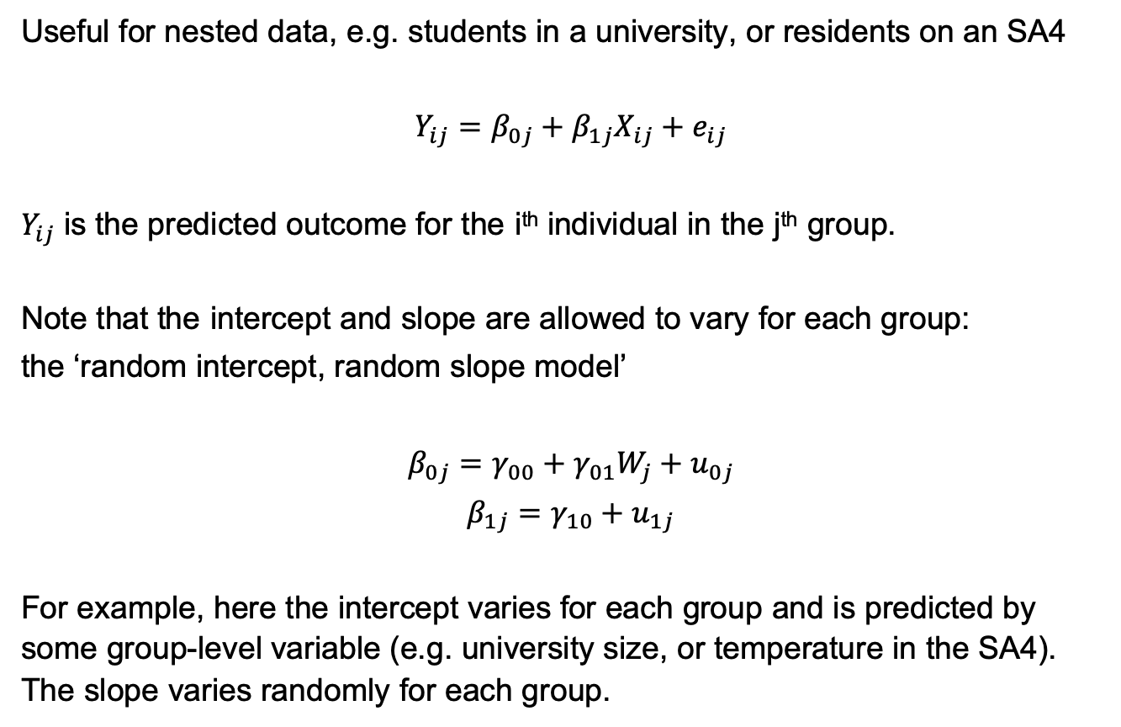
Multilevel model
Useful for nested data, e.g. students in a university, or residents on an SA4
$$Y_{ij}=β_{0j}+β_{1j}X_{ij}+e_{ij}$$
$Y_{ij}$ is the predicted outcome for the i^{th} individual in the j^{th} group.
Note that the intercept and slope are allowed to vary for each group:
the ‘random intercept, random slope model’
$$β_{0j}=γ_{00}+γ_{01}W_{j}+u_{0j}$$
$$β_{1j}=γ_{10}+u_{1j}$$
For example, here the intercept varies for each group and is predicted by some group-level variable (e.g. university size, or temperature in the SA4). The slope varies randomly for each group.

Slide 15
Multilevel model
Useful for nested data, e.g. students in a university, or residents on an SA4
$$Y_{ij}=β_{0j}+β_{1j}X_{ij}+e_{ij}$$
$Y_{ij}$ is the predicted outcome for the i^{th} individual in the j^{th} group.
Note that the intercept and slope are allowed to vary for each group:
the ‘random intercept, random slope model’
$$β_{0j}=γ_{00}+γ_{01}W_{j}+u_{0j}$$
$$β_{1j}=γ_{10}+u_{1j}$$
For example, here the intercept varies for each group and is predicted by some group-level variable (e.g. university size, or temperature in the SA4). The slope varies randomly for each group.

Slide 16
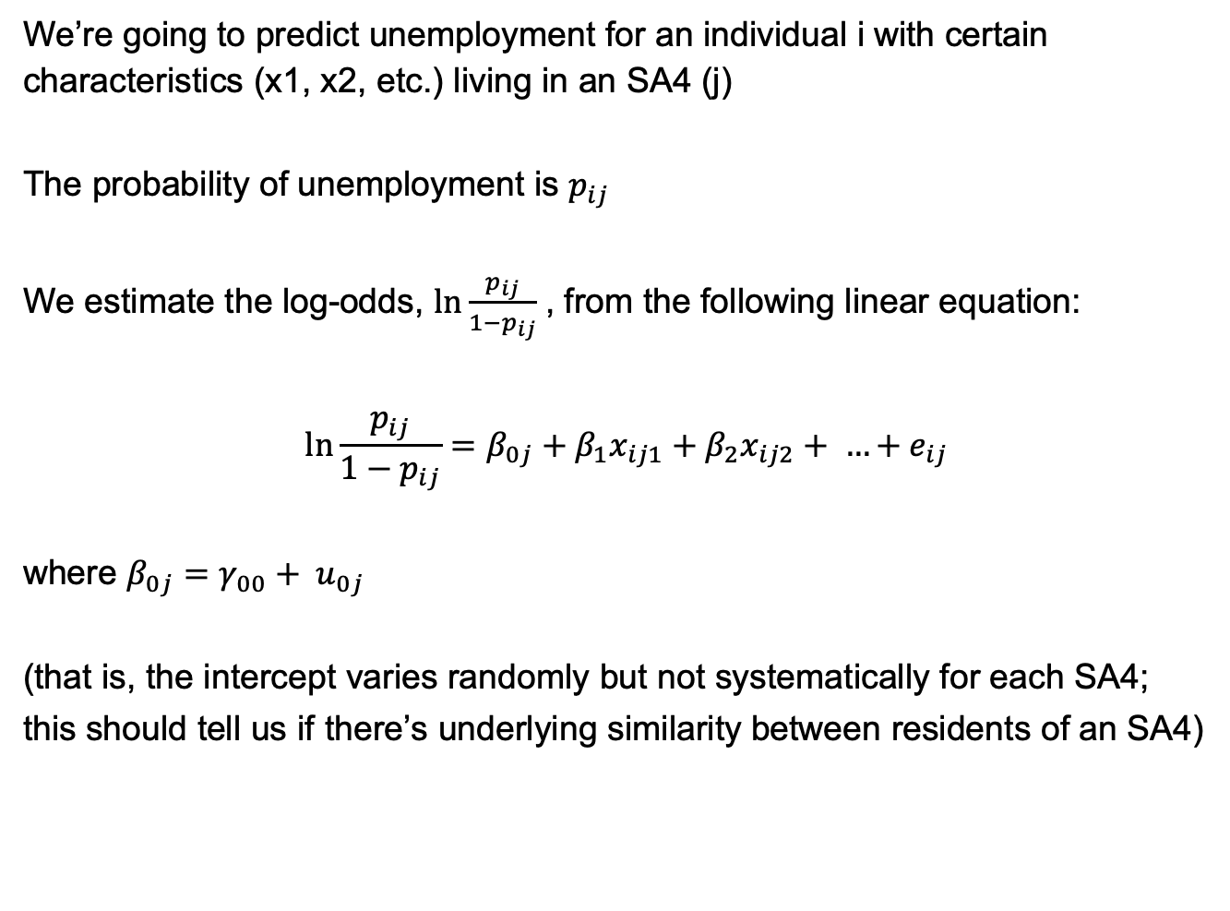
Combining the two concepts
We’re going to predict unemployment for an individual i with certain characteristics (x1, x2, etc.) living in an SA4 (j)
The probability of unemployment is $p_{ij}$
We estimate the log-odds, $\ln{\frac{p_{ij}}{1−p_{ij}}}$ , from the following linear equation:
$$\ln{\frac{p_{ij}}{1−p_{ij}}}=β_{0j}+β_{1}x_{ij1}+β_{2}x_{ij2}+ …+e_{ij}$$
where $β_{0j}=γ_{00}+ u_{0j}$
(that is, the intercept varies randomly but not systematically for each SA4;
this should tell us if there’s underlying similarity between residents of an SA4)
Notes:
Why use SA4s? We expect that different states might have different unemployment rates, due to legislative and compositional differences. SA4s are smaller subunits within states that are designed for the Labour Force Survey. They are meant to represent labour markets within states. So it’s possible that these labour markets have exert group-level effects on the residents, most of whom probably work in the sa4.

Slide 17
Combining the two concepts
We’re going to predict unemployment for an individual i with certain characteristics (x1, x2, etc.) living in an SA4 (j)
The probability of unemployment is $p_{ij}$
We estimate the log-odds, $\ln{\frac{p_{ij}}{1−p_{ij}}}$ , from the following linear equation:
$$\ln{\frac{p_{ij}}{1−p_{ij}}}=β_{0j}+β_{1}x_{ij1}+β_{2}x_{ij2}+ …+e_{ij}$$
where $β_{0j}=γ_{00}+ u_{0j}$
(that is, the intercept varies randomly but not systematically for each SA4;
this should tell us if there’s underlying similarity between residents of an SA4)

Slide 18
What we’ll cover
Recap of:
Logistic regression
Multilevel models
Why some TableBuilder output is effectively unit-record data
A simple unemployment model

Slide 19
Why categorical data is essentially unit-record data
SA4 | Age | Sex | ATSI | Education | LFS
Geelong | 25-29 | Female | No | Bachelor+ | Employed
Geelong | 25-29 | Female | No | Bachelor+ | Employed
Geelong | 25-29 | Female | No | Bachelor+ | Unemployed
Geelong | 25-29 | Female | No | Bachelor+ | Unemployed
Geelong | 25-29 | Female | No | Bachelor+ | Employed
Same information as:
SA4 | Age | Sex | ATSI | Education | LFS | Count
Geelong | 25-29 | Female | No | Bachelor+ | Employed | 3
Geelong | 25-29 | Female | No | Bachelor+ | Unemployed | 2

Slide 20
Why binned data is not unit-record data
SA4 | Age | Sex | ATSI | Education | Income (weekly)
Geelong | 25-29 | Female | No | Bachelor+ | $2,220
Geelong | 25-29 | Female | No | Bachelor+ | $1,150
Geelong | 25-29 | Female | No | Bachelor+ | $240
Geelong | 25-29 | Female | No | Bachelor+ | $1,300
Geelong | 25-29 | Female | No | Bachelor+ | $750
More information than:
SA4 | Age | Sex | ATSI | Education | Income bracket | Count
Geelong | 25-29 | Female | No | Bachelor+ | $0 - $999 | 2
Geelong | 25-29 | Female | No | Bachelor+ | $1,000 - $1,999 | 2
Geelong | 25-29 | Female | No | Bachelor+ | $2,000 - $3,000 | 1
Geelong | 25-29 | Female | No | Bachelor+ | More than $3,000 | 0

Slide 21
What we’ll cover
Recap of:
Logistic regression
Multilevel models
Why some TableBuilder output is effectively unit-record data
A simple unemployment model

Slide 22
Set-up
Data and script available from:
https://github.com/jamesha95/logistic-table

Slide 23
Steps
Get data from TableBulder (done)
Read TableBuilder output into R (wrangle_TableBuilder_output.R)
Convert to wide-table (logistic_regression.R)
Run the analysis (logistic_regression.R)
Extend the analysis (multilevel_logistic_regression.R)

Slide 24
Step 3
Instead of ‘unit-record data’, we can use TableBuilder output with one trick:
SA4 | Age | Sex | ATSI | Education | LFS | Count
Geelong | 25-29 | Female | No | Bachelor+ | Employed | 3
Geelong | 25-29 | Female | No | Bachelor+ | Unemployed | 2
Geelong | 25-29 | Female | No | Sub-Bach | Employed | 4
Geelong | 25-29 | Female | No | Sub-Bach | Unemployed | 1
spread
SA4 | Age | Sex | ATSI | Education | Unemployed | Employed
Geelong | 25-29 | Female | No | Bachelor+ | 2 | 3
Geelong | 25-29 | Female | No | Sub-Bach | 1 | 4

Slide 25
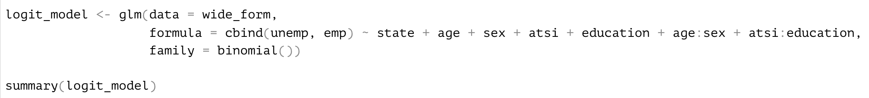
Step 4
Open logistic_regression.R and we’ll go through the steps

Slide 26
The effect of age on unemployment differs for men and women
Probability of unemployment
Notes: Reference person lives in Victoria, does not identify as Aboriginal or Torres Strait Islander, and has a Bachelor degree or higher. The above trend would hold for people of other characteristics, though the absolute level may vary.

Slide 27
Education seems to exert a stronger protecting effect for Aboriginal and Torres Strait Islander people
Probability of unemployment
Notes: Reference person is a 25-29 year old female Victorian. The above trend would hold for people of other characteristics, though the absolute level may vary. NA = Not applicable, NS = Not stated, SC = Supplemental codes (no education or inadequately described)

Slide 28
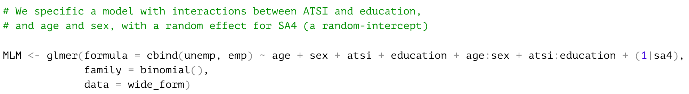
Extending the analysis
Open multilevel_logistic_regression.R and we’ll go through the steps

Slide 29
What does unemployment look like, controlling for residents’ age, sex, ATSI status and education?
Relative odds of unemployment (vs national average)
Built using ‘absmapsdata’

